Slide 1
Processor Scheduling
Outline
8.1 Introduction
8.2 Scheduling Levels
8.3 Preemptive vs. Nonpreemptive Scheduling
8.4 Priorities
8.5 Scheduling Objectives
8.6 Scheduling Criteria
8.7 Scheduling Algorithms
8.7.1 First-In-First-Out (FIFO) Scheduling
8.7.2 Round-Robin (RR) Scheduling
8.7.3 Shortest-Process-First (SPF) Scheduling
8.7.4 Highest-Response-Ratio-Next (HRRN) Scheduling
8.7.5 Shortest-Remaining-Time (SRT) Scheduling
8.7.6 Multilevel Feedback Queues
8.7.7 Fair Share Scheduling
8.8 Deadline Scheduling
8.9 Real-Time Scheduling
8.10 Java Thread Scheduling

Slide 2
Objectives
After reading this chapter, you should understand:
  the goals of processor scheduling.
  preemptive vs. nonpreemptive scheduling.
  the role of priorities in scheduling.
  scheduling criteria.
  common scheduling algorithms.
  the notions of deadline scheduling and real-time scheduling.
  Java thread scheduling.

Slide 3
8.1 Introduction
Processor scheduling policy
  Decides which process runs at given time
  Different schedulers will have different goals
    Maximize throughput
    Minimize latency
    Prevent indefinite postponement
    Complete process by given deadline
    Maximize processor utilization

Slide 4
8.2 Scheduling Levels
High-level scheduling
  Determines which jobs can compete for resources
  Controls number of processes in system at one time
Intermediate-level scheduling
  Determines which processes can compete for processors
  Responds to fluctuations in system load
Low-level scheduling
  Assigns priorities
  Assigns processors to processes

Slide 5
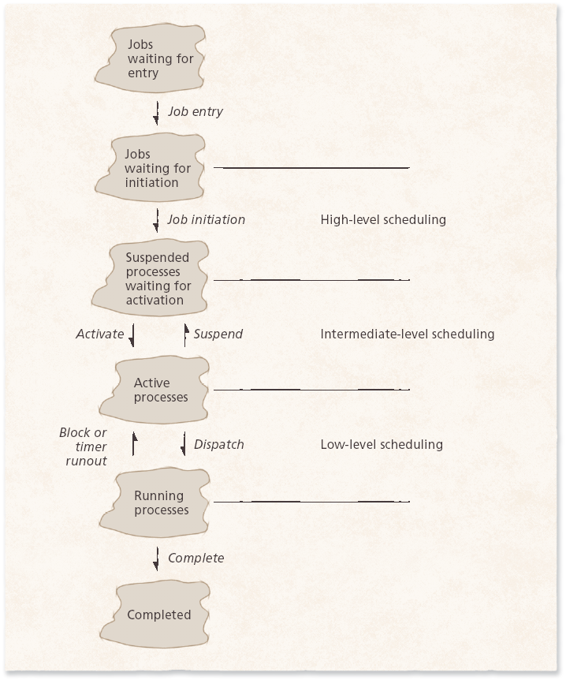
8.2 Scheduling Levels
Figure 8.1 Scheduling levels.

Slide 6
8.3 Preemptive vs. Nonpreemptive Scheduling
Preemptive processes
  Can be removed from their current processor
  Can lead to improved response times
  Important for interactive environments
  Preempted processes remain in memory
Non-preemptive processes
  Run until completion or until they yield control of a processor
  Unimportant processes can block important ones indefinitely

Slide 7
8.4 Priorities
Static priorities
  Priority assigned to a process does not change
  Easy to implement
  Low overhead
  Not responsive to changes in environment
Dynamic priorities
  Responsive to change
  Promote smooth interactivity
  Incur more overhead than static priorities
    Justified by increased responsiveness

Slide 8
8.5 Scheduling Objectives
Different objectives depending on system
  Maximize throughput
  Maximize number of interactive processes receiving acceptable response times
  Minimize resource utilization
  Avoid indefinite postponement
  Enforce priorities
  Minimize overhead
  Ensure predictability

Slide 9
8.5 Scheduling Objectives
Several goals common to most schedulers
  Fairness
  Predictability
  Scalability

Slide 10
8.6 Scheduling Criteria
Processor-bound processes
  Use all available processor time
I/O-bound
  Generates an I/O request quickly and relinquishes/ abandon something: to give something up or put something aside processor
Batch processes
  Contains work to be performed with no user interaction
Interactive processes
  Requires frequent user input

Slide 11
8.7 Scheduling Algorithms
Scheduling algorithms
  Decide when and for how long each process runs
  Make choices about
    Preemptibility
    Priority
    Running time
    Run-time-to-completion
    fairness

Slide 12
8.7.1 First-In-First-Out (FIFO) Scheduling
FIFO scheduling
  Simplest scheme
  Processes dispatched according to arrival time
  Nonpreemptible
  Rarely used as primary scheduling algorithm

Slide 13
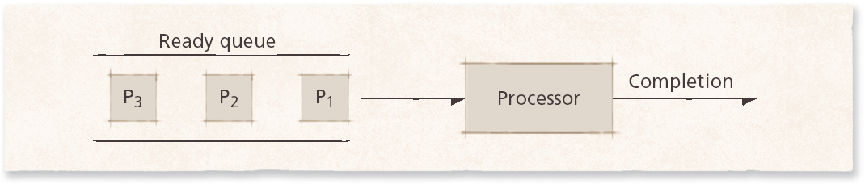
8.7.1 First-In-First-Out (FIFO) Scheduling
Figure 8.2 First-in-first-out scheduling.

Slide 14
8.7.2 Round-Robin (RR) Scheduling
Round-robin scheduling
  Based on FIFO
  Processes run only for a limited amount of time called a time slice or quantum
  Preemptible
  Requires the system to maintain several processes in memory to minimize overhead
  Often used as part of more complex algorithms

Slide 15
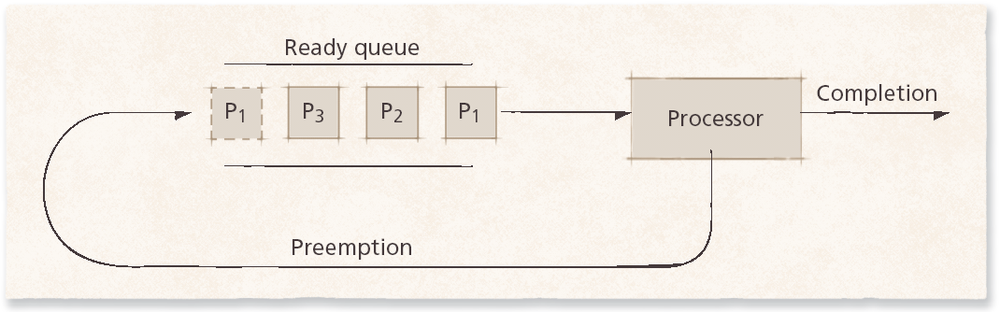
8.7.2 Round-Robin (RR) Scheduling
Figure 8.3 Round-robin scheduling.

Slide 16
8.7.2 Round-Robin (RR) Scheduling
Selfish round-robin scheduling
  Increases priority as process ages
  Two queues
    Active
    Holding
  Favors older processes to avoid unreasonable delays

Slide 17
8.7.2 Round-Robin (RR) Scheduling
Quantum size
  Determines response time to interactive requests
  Very large quantum size
    Processes run for long periods
    Degenerates to FIFO
  Very small quantum size
    System spends more time context switching than running processes
  Middle-ground
    Long enough for interactive processes to issue I/O request
    Batch processes still get majority of processor time

Slide 18
8.7.3 Shortest-Process-First (SPF) Scheduling
Scheduler selects process with smallest time to finish
  Lower average wait time than FIFO
    Reduces the number of waiting processes
  Potentially large variance in wait times
  Nonpreemptive
    Results in slow response times to arriving interactive requests
  Relies on estimates of time-to-completion
    Can be inaccurate or falsified/ misrepresent: to misrepresent the facts in order to mislead
  Unsuitable for use in modern interactive systems

Slide 19
8.7.4 Highest-Response-Ratio-Next (HRRN) Scheduling
HRRN scheduling
  Improves upon SPF scheduling
  Still nonpreemptive
  Considers how long process has been waiting
  Prevents indefinite postponement

Slide 20
8.7.5 Shortest-Remaining-Time (SRT) Scheduling
SRT scheduling
  Preemptive version of SPF
  Shorter arriving processes preempt a running process
  Very large variance of response times: long processes wait even longer than under SPF
  Not always optimal
    Short incoming process can preempt a running process that is near completion
    Context-switching overhead can become significant

Slide 21
8.7.6 Multilevel Feedback Queues
Different processes have different needs
  Short I/O-bound interactive processes should generally run before processor-bound batch processes
  Behavior patterns not immediately obvious to the scheduler
Multilevel feedback queues
  Arriving processes enter the highest-level queue and execute with higher priority than processes in lower queues
  Long processes repeatedly descend into lower levels
    Gives short processes and I/O-bound processes higher priority
    Long processes will run when short and I/O-bound processes terminate
  Processes in each queue are serviced using round-robin
    Process entering a higher-level queue preempt running processes

Slide 22
8.7.6 Multilevel Feedback Queues
Algorithm must respond to changes in environment
  Move processes to different queues as they alternate between interactive and batch behavior
Example of an adaptive mechanism
  Adaptive mechanisms incur overhead that often is offset by increased sensitivity to process behavior

Slide 23
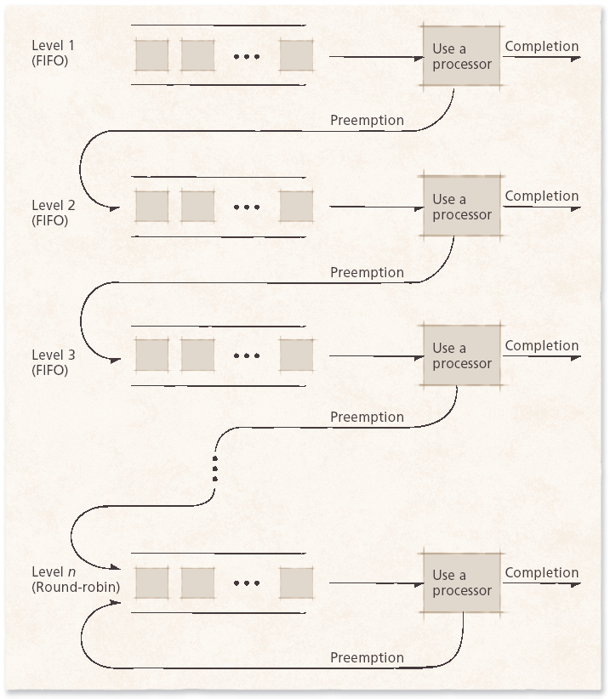
8.7.6 Multilevel Feedback Queues
Figure 8.4 Multilevel feedback queues.

Slide 24
8.7.7 Fair Share Scheduling
FSS controls users’ access to system resources
  Some user groups more important than others
  Ensures that less important groups cannot monopolize resources
  Unused resources distributed according to the proportion of resources each group has been allocated
  Groups not meeting resource-utilization goals get higher priority

Slide 25
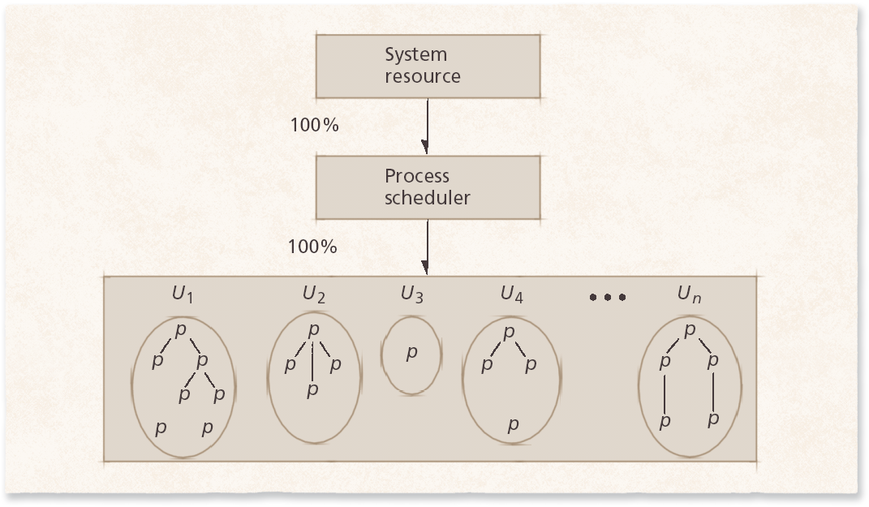
8.7.7 Fair Share Scheduling
Figure 8.5 Standard UNIX process scheduler. The scheduler grants the processor
to users, each of whom may have many processes. (Property of AT&T Archives.
Reprinted with permission of AT&T.)

Slide 26
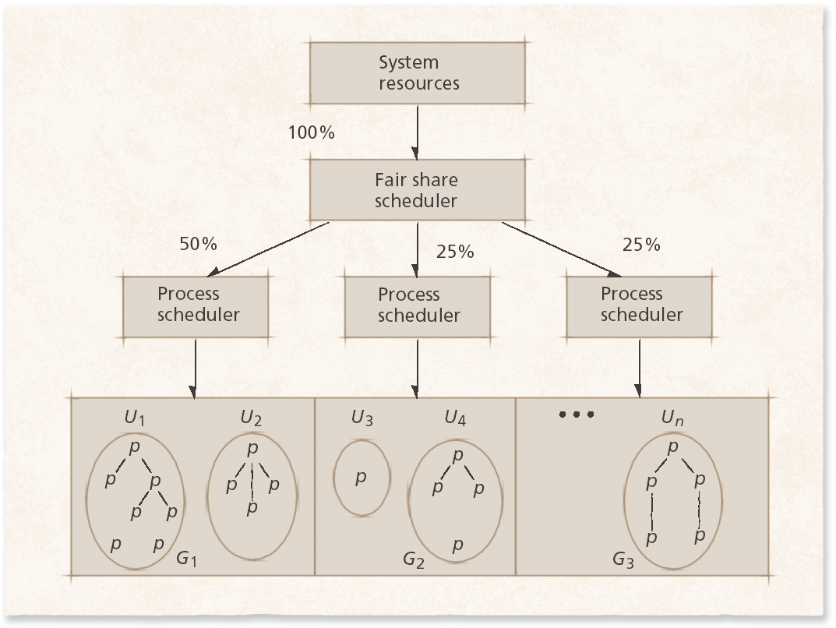
8.7.7 Fair Share Scheduling
Figure 8.6 Fair share scheduler. The fair share scheduler divides system resource
capacity into portions, which are then allocated by process schedulers assigned to
various fair share groups. (Property of AT&T Archives. Reprinted with permission of
AT&T.)

Slide 27
8.8 Deadline Scheduling
Deadline scheduling
  Process must complete by specific time
  Used when results would be useless if not delivered on-time
  Difficult to implement
    Must plan resource requirements in advance
    Incurs significant overhead
    Service provided to other processes can degrade

Slide 28
8.9 Real-Time Scheduling
Real-time scheduling
  Related to deadline scheduling
  Processes have timing constraints
  Also encompasses tasks that execute periodically
Two categories
  Soft real-time scheduling
    Does not guarantee that timing constraints will be met
    For example, multimedia playback
  Hard real-time scheduling
    Timing constraints will always be met
    Failure to meet deadline might have catastrophic/ disastrous: causing or liable to cause widespread damage or death results
    For example, air traffic control

Slide 29
8.9 Real-Time Scheduling
Static real-time scheduling
  Does not adjust priorities over time
  Low overhead
  Suitable for systems where conditions rarely change
    Hard real-time schedulers
  Rate-monotonic (RM) scheduling
    Process priority increases monotonically with the frequency with which it must execute
  Deadline RM scheduling
    Useful for a process that has a deadline that is not equal to its period

Slide 30
8.9 Real-Time Scheduling
Dynamic real-time scheduling
  Adjusts priorities in response to changing conditions
  Can incur significant overhead, but must ensure that the overhead does not result in increased missed deadlines
  Priorities are usually based on processes’ deadlines
    Earliest-deadline-first (EDF)
      Preemptive, always dispatch the process with the earliest deadline
    Minimum-laxity-first
      Similar to EDF, but bases priority on laxity, which is based on the process’s deadline and its remaining run-time-to-completion

Slide 31
8.10 Java Thread Scheduling
Operating systems provide varying thread scheduling support
  User-level threads
    Implemented by each program independently
    Operating system unaware of threads
  Kernel-level threads
    Implemented at kernel level
    Scheduler must consider how to allocate processor time to a process’s threads

Slide 32
8.10 Java Thread Scheduling
Java threading scheduler
  Uses kernel-level threads if available
  User-mode threads implement timeslicing
    Each thread is allowed to execute for at most one quantum before preemption
  Threads can yield to others of equal priority
    Only necessary on nontimesliced systems
    Threads waiting to run are called waiting, sleeping or blocked

Slide 33
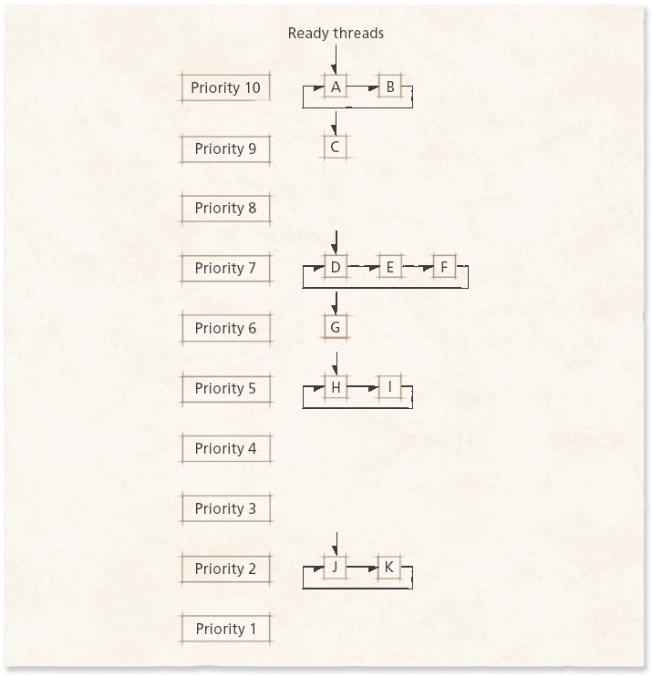
8.10 Java Thread Scheduling
Figure 8.7 Java thread priority scheduling.

